Slide 1
European Initiative for the exchange of young officers inspired by Erasmus
The Initiative
Erasmus
Militaire
Military
Erasmus
EMILYO

Slide 2
Contents of the Briefing
How …. | and why the Initiative began?
Who …. | is involved in the Initiative?
What …. | are we doing?
Cui bono? | Who benefits what?
Future …. | Developments
Kind … | Requests

Slide 3
Aim of the Briefing
Information about the work of the Implementation Group (IG) “European Initiative for the exchange of young officers inspired by Erasmus” during the study year 2021 / 2022
Way ahead (based on your decisions)
Some (few) kind requests

Slide 4
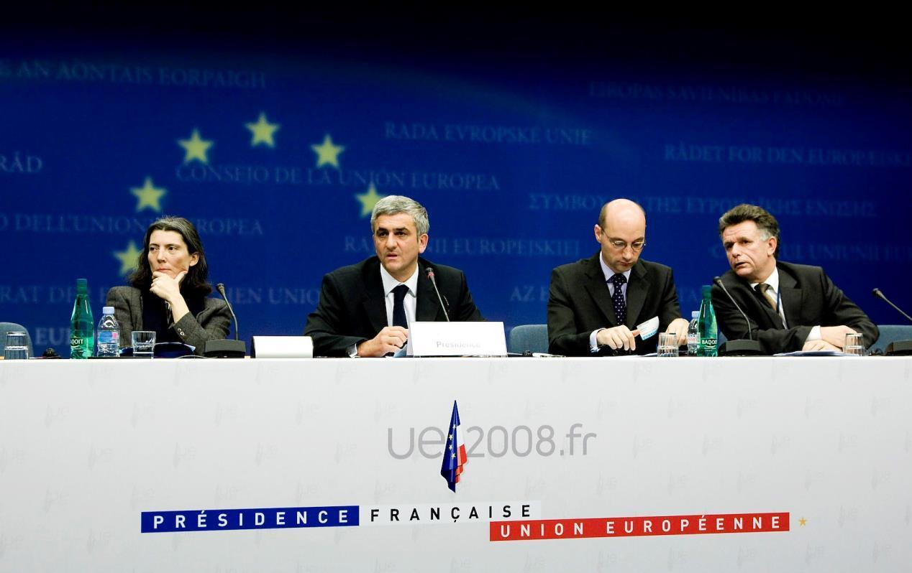
How it began (Nov. 2008) ➔ Declaration of all EU Ministers of Defence
Establish an Implementation Group (IG) for the „European initiative for the exchange of young officers inspired by Erasmus“
Goals: Increase interoperability & “harmonise” EU Basic Officer Education – thus, promote a “European Security and Defence Culture”
Source: Council of the European Union, Council Conclusions on the ESDP, 2903rd External Relations Council Meeting. Brussels. 10th and 11th November, 2008.

Slide 5
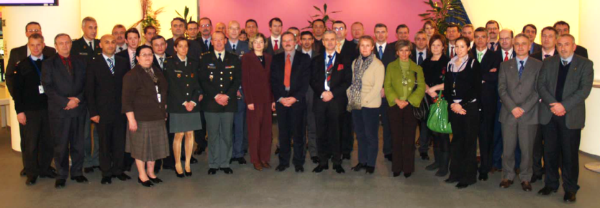
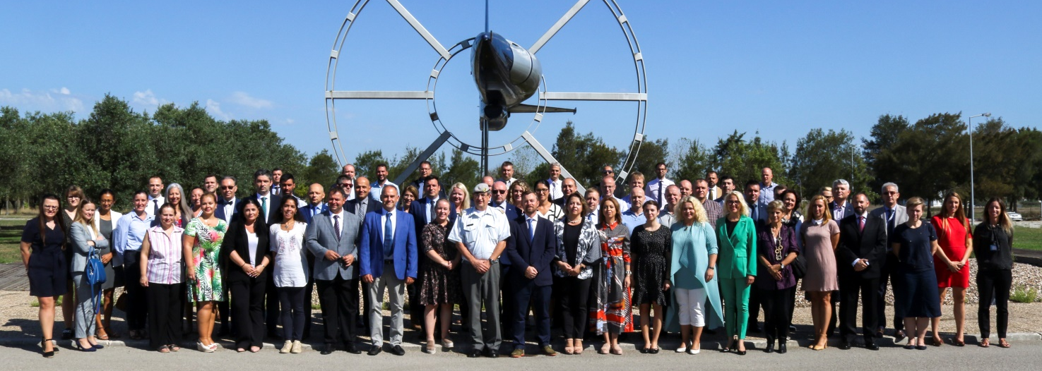
How it began First & latest Meeting of the Implementation Group
February 2009:
1st IG meeting
Meanwhile
(Sep 2022):
55th IG
meeting
(quarterly
basis)

Slide 6
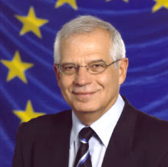
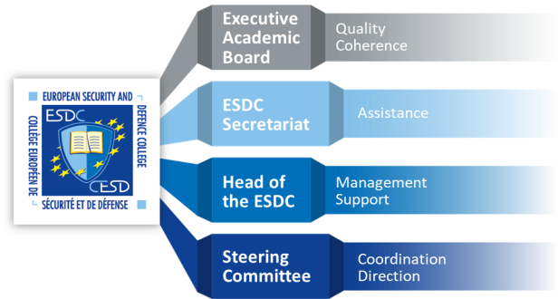
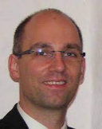
Who is involved in the Initiative
Josep
Borrell
Mr. Holger
Osterrieder
HR/VP
European External Action Service (EEAS)
“EU Ministry of Foreign Affairs”
WGMOT
EUMSSF
XY
XY
CMPD
Crisis Management and Planning Directorate
CSDP DocSch
EAB.SSR
Implementation Group
Basic Officer Education Institutions’ Representatives
SQF-MILOF WG
EAB.Cyber platform
National Representatives
~ 27 EU Member States + 1 Assoc. Member
~ 65 EU Basic Officer Education Institutions
Army
Air Force
Navy
Technical
Medical
Military Force charged with Police Duties (e.g.: Carabinieri)
Militarised Police Force (e.g.: Guardia di Finanza)

Slide 7
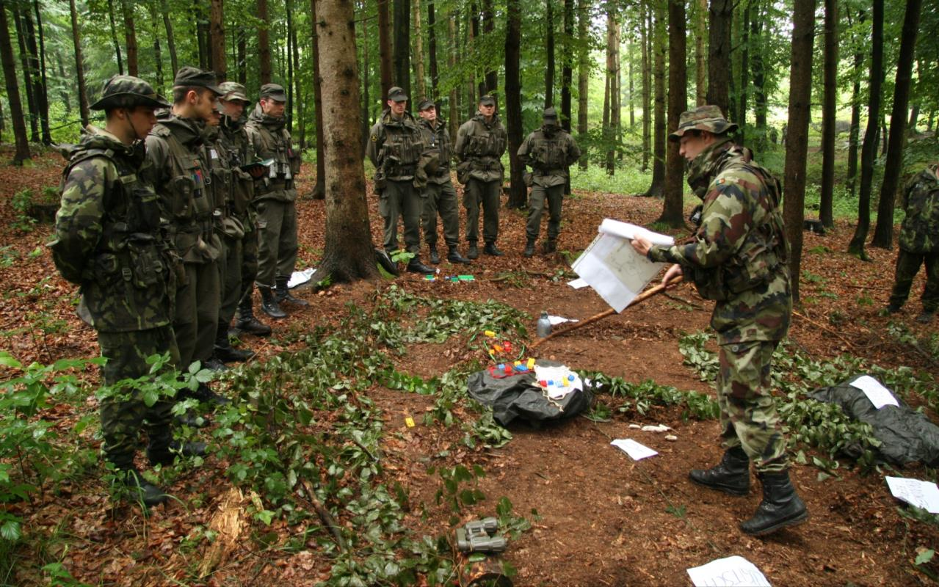
What are we doing? Lines of Development – Overview
LoD No. | LoD Name | Solved | On-going
1 | System of Equivalences | R
2 | Development of Competences | R | S
3 | Development of IDL/e-learning | R | S
4 | Create an IT-Platform (www.emilyo.eu) | R
5 | (Legal) Framework | R
6 | Strategic Communication | R | S
7 | Financing the Initiative | R | S
8 | Common Modules | R | S
9 | Future Projects | R | S
10 | Gender Mainstreaming | R | S
11 | International Naval Semester |  | S
12 | International Air Force Semester | R
13 | International Technical Semester | R | S
14 | Research & Development | R | S
15 | International Medical Semester |  | S
16 | European Union Military Academy |  | S
17 | International Air Defence Semester |  | S

Slide 8
What are we doing? Lines of Development – Chairpersons (Thank YOU!!)
No. | LoD Name | Chairperson | BOEI
1 | System of Equivalences | (Col Assoc. Prof. GELL Harald, PhD) | AT-TMA
2 | Development of Competences | Capt (N) Assoc. Prof. DIMITROV Nedko, PhD | BG-NVNA
3 | Development of e-learning | (Col Assoc. Prof. GELL Harald, PhD) | AT-TMA
4 | Create an IT-Platform | Assoc. Prof. KARADIMAS Nikolaos V., PhD | GR-HAA
5 | (Legal) Framework | (Col Assoc. Prof. GELL Harald, PhD) | AT-TMA
6 | Strategic Communication | Maj CHRISTOFOROU Christoforos | CY-CSDA
7 | Financing the Initiative | Col MACHADO Paulo, MSc | PT-PMA
8 | Common Modules | LtCol SPINELLO Enrico | IT-SAMS
9 | Future Projects | Assoc. Prof. WINCEWICZ-BOSY Marta, PhD | PL-AWL
10 | Gender Mainstreaming | Col Assoc. Prof. ATANASOVA-KRASTEVA Nevena, PhD | BG-NDU
11 | International Naval Semester | Col Assoc. Prof. POPA Catalin, PhD | RO-RNA
12 | International Air Force Semester | Assist. Prof. KARAMPELAS Panagiotis, PhD | GR-HAFA
13 | International Technical Semester | Col Prof. Eng. MOLDOVEANU Cristian Emil, PhD | RO-MTA
14 | Research & Development | Assoc. Prof. TEMPLALEXIS Ioannis, PhD | GR-HAFA
15 | International Medical Semester | LtCol KAZAKIS Ioannis, DVM | GR-HMACSO
16 | EU Military Academy | (Col Assoc. Prof. GELL Harald, PhD) | AT-TMA
17 | Int’l Air Defence Semester | Col Assoc. Prof. GHERMAN Laurian, PhD | RO-HCAFA

Slide 9
What are we doing? Meetings
IG
Meeting
IG
Meeting
IG
Meeting
IG
Meeting
Jan | Feb | Mar | Apr | May | Jun | Jul | Aug | Sep | Oct | Nov | Dec
EUAFA?
iMAF
EUMACS
(all Services)
LoD
Meeting(s)
CSDP-
Olympiad
(each 2 years)
LoD
VTCs
Strategic
Partner-
ships

Slide 10
What are we doing? Achievements ➔ Lines of Development
LoD No. | LoD Name | Solved | On-going
1 | System of Equivalences | R
2 | Development of Competences | R | S
3 | Development of IDL/e-learning | R | S
4 | Create an IT-Platform (www.emilyo.eu) | R
5 | (Legal) Framework | R
6 | Strategic Communication | R | S
7 | Financing the Initiative | R | S
8 | Common Modules | R | S
9 | Future Projects | R | S
10 | Gender Mainstreaming | R | S
11 | International Naval Semester |  | S
12 | International Air Force Semester | R
13 | International Technical Semester | R | S
14 | Research & Development | R | S
15 | International Medical Semester |  | S
16 | European Union Military Academy |  | S
17 | International Air Defence Semester |  | S

Slide 11
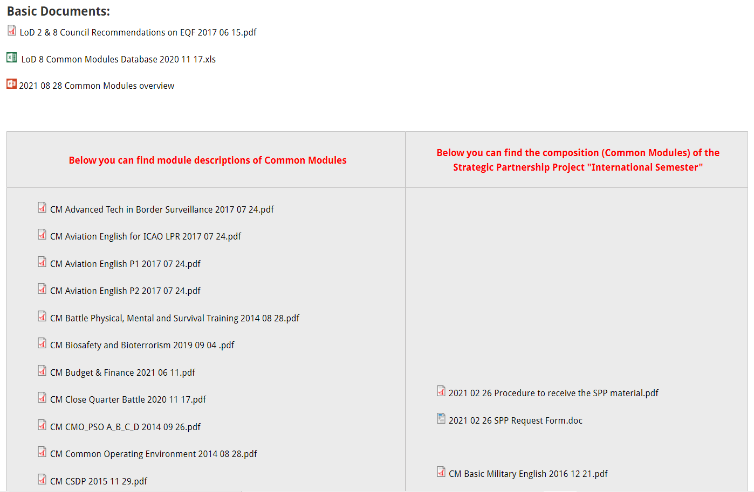
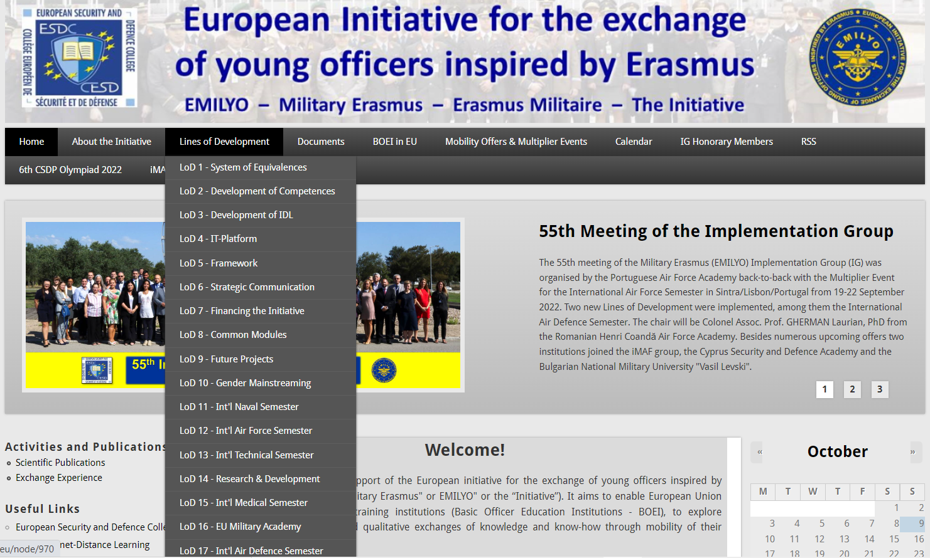
What are we doing? Achievements ➔ Lines of Development
+ ESDC e-learning!
All the learning material
e-books
e-learning
ppt-slides
tests
etc.
is already elaborated and can be used for free

Slide 12
What are we doing? Achievements ➔ Lines of Development
LoD No. | LoD Name | Solved | On-going
1 | System of Equivalences | R
2 | Development of Competences | R | S
3 | Development of IDL/e-learning | R | S
4 | Create an IT-Platform (www.emilyo.eu) | R
5 | (Legal) Framework | R
6 | Strategic Communication | R | S
7 | Financing the Initiative | R | S
8 | Common Modules | R | S
9 | Future Projects | R | S
10 | Gender Mainstreaming | R | S
11 | International Naval Semester |  | S
12 | International Air Force Semester | R
13 | International Technical Semester | R | S
14 | Research & Development | R | S
15 | International Medical Semester |  | S
16 | European Union Military Academy |  | S
17 | International Air Defence Semester |  | S

Slide 13
What are we doing? Achievements ➔ Lines of Development
Information to / during ….
EUMC (your ChoDs)
Defence Policy Directors
annual letter to Commandants & Superintendents
EUMACSs (all services)
iMAFs (all services)
CSDP Olympiads
other conferences (e.g.: EUAFA)
bilateral basis on request
European Parliament
… publications ➔ ➔
⬅ ⬅

Slide 14
What are we doing? Achievements ➔ Lines of Development
LoD No. | LoD Name | Solved | On-going
1 | System of Equivalences | R
2 | Development of Competences | R | S
3 | Development of IDL/e-learning | R | S
4 | Create an IT-Platform (www.emilyo.eu) | R
5 | (Legal) Framework | R
6 | Strategic Communication | R | S
7 | Financing the Initiative | R | S
8 | Common Modules | R | S
9 | Future Projects | R | S
10 | Gender Mainstreaming | R | S
11 | International Naval Semester |  | S
12 | International Air Force Semester | R
13 | International Technical Semester | R | S
14 | Research & Development | R | S
15 | International Medical Semester |  | S
16 | European Union Military Academy |  | S
17 | International Air Defence Semester |  | S

Slide 15
What are we doing? Achievements ➔ Lines of Development
How to finance?
ERASMUS+ exchange rules (cadets, lecturers, staff)
ERASMUS+ Strategic Partnership Projects
LoD 5 Framework
developed by lawyers
just 10+2 countries opted in
iMAF 2016
book (how to use external funds) ➔ ➔
ESDC co-financing
Institutions‘ (military) budget

Slide 16
What are we doing? Achievements ➔ Lines of Development
LoD No. | LoD Name | Solved | On-going
1 | System of Equivalences | R
2 | Development of Competences | R | S
3 | Development of IDL/e-learning | R | S
4 | Create an IT-Platform (www.emilyo.eu) | R
5 | (Legal) Framework | R
6 | Strategic Communication | R | S
7 | Financing the Initiative | R | S
8 | Common Modules | R | S
9 | Future Projects | R | S
10 | Gender Mainstreaming | R | S
11 | International Naval Semester |  | S
12 | International Air Force Semester | R
13 | International Technical Semester | R | S
14 | Research & Development | R | S
15 | International Medical Semester |  | S
16 | European Union Military Academy |  | S
17 | International Air Defence Semester |  | S

Slide 17
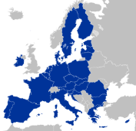
Common Module What is it?
Request comments
from 65 BOEI (or MOD)
Proposed Module
Cultural
Awareness
(2 ECTS)
Proposed Module
Electronic
Warfare
(2 ECTS)
Proposed Module
Fighting in
Build-Up Areas
(3 ECTS)
IG + LoD 2+8 Chairmen
pre-check:
Strategy
Goal-correctness
Learning Outcomes acc. to SQF MILOF
ECTS correctness (law, regulations)
Strategic Partnership
Implementation Group
BOEI Representatives
~ 80 Education
Experts
5 BOE
Institutions
Experts from
BOEI & MOD
Implemen-
tation
(national
Curricula)
Regular
adjustment(s)
see:
http://www.emilyo.eu/node/988
Approved
Common Module
XXXX
(X ECTS)
External Evaluation?
Internal Quality
Assurance System

Slide 18
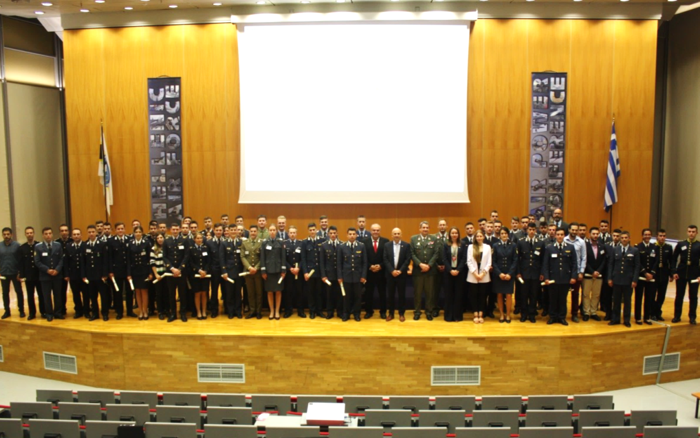
What are we doing? Achievements ➔ Lines of Development
Common Module | ECTS |  | Common Module | ECTS
Advanced Technologies in Borders Surveillance | 2 |  | IMINT-GEOINT Analysis Course | 2
Aviation English for ICAO LPR | 3 |  | Individual Personal Development and Meta-Communication | 2
Aviation English P1 | 3 |  | Interoperability | 6
Aviation English P2 | 3 |  | Irregular Warfare | 3
Basic Military English | 2 |  | Law of Armed Conflict | 2
Battle Physical, Mental and Survival Training | 3 |  | Leadership & Agility in Complex Environments | 2
Biosafety and Bioterrorism | 2 |  | Leadership in Communication – IMLA | 2
Budget & Finance in EU Defence | 2 |  | Leadership, Motivation and Influence – IMLA | 2
Close Quarter Battle | 3 |  | Maritime Leadership | 2
Common Operating Environment | 3 |  | Maritime Security | 2
Common Security and Defence Policy | 2 |  | Military Ethics (A) | 2
Comprehensive Approach | 4 |  | Military Ethics (B) | 2
CMO/PSO (4 Sub-Modules [A, B, C, D]) | 12 |  | Military Instructor Training | 3
Crisis Management (Military Leadership) – IMLA | 2 |  | Military Leadership (A) | 2
Crises Management Operations (CMO) | 3 |  | Military Leadership (B) | 2
Cross Cultural Communication | 2 |  | Military Leadership (C) | 4
CSDP-Olympiad | 2 |  | Military Strategy and Security in the Baltic Sea Region | 3
Cultural Awareness | 2 |  | Senior Cadets’ Seminar on Leadership | 1.5
Cyber Security | 2 |  | Small Unit Tactics | 4
Defence and Security Economics | 4 |  | Social Engineering Protection | 2
Digital Leadership | 3 |  | Space Applications for Security and Defence | 2
Electronic Warfare | 2 |  | Stress Management – IMLA | 2
English for Aircraft Maintenance SET P1 | 3 |  | Troop Leading Procedures | 1
English for Aircraft Maintenance SET P2 | 3 |  | Technologies in Cyber Security | 2
English for Aircraft Maintenance SET P3 | 3 |  | Unmanned Aerial Systems | 2
English for Aviation Security Personnel | 3 |  | Winter Warfare Basic Module | 2
Fighting In Built Up Area | 3 |  | (NCN/Intern) Aerospace Technology (PL / MUT) | (8)
Gender Perspectives in Security and Defence | 2 |  | (NCM/Intern) Armament and Missile Technology (PL / MUT) | (8)
How to meet the Media | 2 |  | Total: 55 | 146.5

Slide 19
What are we doing? Achievements ➔ Lines of Development
LoD No. | LoD Name | Solved | On-going
1 | System of Equivalences | R
2 | Development of Competences | R | S
3 | Development of IDL/e-learning | R | S
4 | Create an IT-Platform (www.emilyo.eu) | R
5 | (Legal) Framework | R
6 | Strategic Communication | R | S
7 | Financing the Initiative | R | S
8 | Common Modules | R | S
9 | Future Projects | R | S
10 | Gender Mainstreaming | R | S
11 | International Naval Semester |  | S
12 | International Air Force Semester | R
13 | International Technical Semester | R | S
14 | Research & Development | R | S
15 | International Medical Semester |  | S
16 | European Union Military Academy |  | S
17 | International Air Defence Semester |  | S

Slide 20
What are we doing? Achievements ➔ Lines of Development
Sep 2018
1st E+ Gender
Seminar (TMA/AT)
Oct 2019
2nd E+ Gender
Seminar
Mar 2021
3rd E+ Gender
Seminar
May 2022
4th E+ Gender
Seminar
2020 ➔
LoD 10 subgroup
meetings
Analysing good practices
Dec 2020
(2020-2023)
SPP Military Gender Studies
2021-2022
MGS Project
development
Content of new CM (syllabus preparation
and reviews, learning materials, etc.)
Nov 2022
1st Common Module (pilot)
TMA/Austria
Nov 2018
NEW!
LoD 10 Gender
Mainstreaming
Feb 2019
Gender Education Questionnaire
Collecting data (in progress)
scientific reports
Partners:
PT – MA (coordinator)
BG – NMU
IT – UoT
RO – LFA

Slide 21
What are we doing? Achievements ➔ Lines of Development
LoD No. | LoD Name | Solved | On-going
1 | System of Equivalences | R
2 | Development of Competences | R | S
3 | Development of IDL/e-learning | R | S
4 | Create an IT-Platform (www.emilyo.eu) | R
5 | (Legal) Framework | R
6 | Strategic Communication | R | S
7 | Financing the Initiative | R | S
8 | Common Modules | R | S
9 | Future Projects | R | S
10 | Gender Mainstreaming | R | S
11 | International Naval Semester |  | S
12 | International Air Force Semester | R
13 | International Technical Semester | R | S
14 | Research & Development | R | S
15 | International Medical Semester |  | S
16 | European Union Military Academy |  | S
17 | International Air Defence Semester |  | S

Slide 22
What are we doing? Achievements ➔ Lines of Development
INTERNATIONAL NAVAL SEMESTER | ECTS
ENGLISH NAVAL TERMINOLOGY | 2
NAVAL SENSORS | 2
NAVAL ELECTRONICS | 2
OCEANOGRAPHY | 2
MARITIME SECURITY | 2
NAVAL ARCHITECTURE | 4
NAVAL POWER PLANTS | 2
NAVAL LEADERSHIP | 2
NAVAL COMMUNICATIONS | 2
NAVAL COMPUTER NETWORK | 2
NAVAL CYBER THREATS (RESILIENCE+SECURITY) | 4
MILITARY LEADERSHIP C (PHYSICAL TRAINING) | 2 + 2
 | 30
Idea:
12 new common modules
Strategic Partnership Project should be launched in 2023
EXTRA WORK | ECTS
NAVAL ARCHITECTURE | 2
NAVAL POWER PLANTS | 2
NAVAL SENSORS | 2
 | 6

Slide 23
What are we doing? Achievements ➔ Lines of Development
LoD No. | LoD Name | Solved | On-going
1 | System of Equivalences | R
2 | Development of Competences | R | S
3 | Development of IDL/e-learning | R | S
4 | Create an IT-Platform (www.emilyo.eu) | R
5 | (Legal) Framework | R
6 | Strategic Communication | R | S
7 | Financing the Initiative | R | S
8 | Common Modules | R | S
9 | Future Projects | R | S
10 | Gender Mainstreaming | R | S
11 | International Naval Semester |  | S
12 | International Air Force Semester | R
13 | International Technical Semester | R | S
14 | Research & Development | R | S
15 | International Medical Semester |  | S
16 | European Union Military Academy |  | S
17 | International Air Defence Semester |  | S

Slide 24
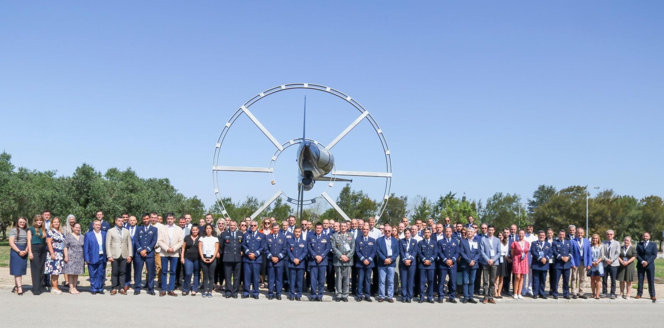
What are we doing? Achievements ➔ Lines of Development
2022 | 2023
GR – HAFA | PL - PAFU
PT – PTAFA | ?
RO - HCAFA
Sintra
Portugal
20 September 2022

Slide 25
What are we doing? Achievements ➔ Lines of Development
Module name | ECTS | Responsibility
Cyber Warfare | 2 | HAFA
Military Ethics | 2 | HAFA
Common Security & Defence Policy | 2 | HAFA
Space Applications for Security and Defence | 2 | HAFA
Aviation Meteorology | 2 | AFAHC
Flight & Ground Safety | 2 | PTAFA
Aviation English | 4 | AFAHC
Aerial Navigation | 2 | AFAHC
Avionics Systems | 4 | PTAFA
Propulsion Systems | 2 | PTAFA
Total | 24
National Requirements | 6
6 new common modules (process of “common” open)

Slide 26
What are we doing? Achievements ➔ Lines of Development
LoD No. | LoD Name | Solved | On-going
1 | System of Equivalences | R
2 | Development of Competences | R | S
3 | Development of IDL/e-learning | R | S
4 | Create an IT-Platform (www.emilyo.eu) | R
5 | (Legal) Framework | R
6 | Strategic Communication | R | S
7 | Financing the Initiative | R | S
8 | Common Modules | R | S
9 | Future Projects | R | S
10 | Gender Mainstreaming | R | S
11 | International Naval Semester |  | S
12 | International Air Force Semester | R
13 | International Technical Semester | R | S
14 | Research & Development | R | S
15 | International Medical Semester |  | S
16 | European Union Military Academy |  | S
17 | International Air Defence Semester |  | S

Slide 27
What are we doing? Achievements ➔ Lines of Development
Jun 2021
Mar 2022
Pilot Events
Syllabus Preparation (in progress)
MTA (Mar 2022)
FAFA (Apr 2022)
MUT (May 2022)
NMU (Jun 2022)
HAFA (Jul 2022)
syllabus preparation (Sept. 2021)
syllabus finalisation (Dec. 2021)
Curriculum design
Teaching Materials & E-learning platform
Selection of subjects (April)
Curriculum finalisation (September)
First draft (Feb 2022)
Finalisation (Nov 2022)
May 2023
last
SPP ME
Dec 2020
Sep 2021
E_{U}CTS_{DS}
SPP Partners:
RO – MTA (coordinator)
BG – NMU
FR – FASFA
GR – HAFA
PL – MUT

Slide 28
What are we doing? Achievements ➔ Lines of Development
Module name | ECTS | Responsibility
Applied Informatics Applied Automation for Eng. Systems | 3 3 | MTA
Integrated Weapon Systems CSDP for Technical Systems | 3 3 | FASFA
Computer Networks Programming Languages Signal Processing Microcontrollers | 3 3 3 3 | NMU
Propulsion Systems Dynamic of Flight Mechanics and Material Science CAD and Numerical Analysis | 3 3 3 3 | MUT
Interdisciplinary Scientific Project | 6 | HAFA
Total | 42
13 new common modules
Electronic & IT option
Mec. & Aero. option

Slide 29
What are we doing? Achievements ➔ Lines of Development
LoD No. | LoD Name | Solved | On-going
1 | System of Equivalences | R
2 | Development of Competences | R | S
3 | Development of IDL/e-learning | R | S
4 | Create an IT-Platform (www.emilyo.eu) | R
5 | (Legal) Framework | R
6 | Strategic Communication | R | S
7 | Financing the Initiative | R | S
8 | Common Modules | R | S
9 | Future Projects | R | S
10 | Gender Mainstreaming | R | S
11 | International Naval Semester |  | S
12 | International Air Force Semester | R
13 | International Technical Semester | R | S
14 | Research & Development | R | S
15 | International Medical Semester |  | S
16 | European Union Military Academy |  | S
17 | International Air Defence Semester |  | S

Slide 30
What are we doing? Achievements ➔ Lines of Development
2020-2021
2023
Put in place a consortium to develop tools and processes to communicate research and strengthen the network of researchers.
Creation of forms to collect relevant data (thesis titles, academic status of IG members)
Foundation
First common thesis decided to run in parallel between HAFA and MUT
Sep 2020
2021-2022
On going actions:
Populate the list of future thesis topics
Promote participation of IG members into established conferences
Promote placement of students as part of their MSc’s or PhD’s project

Slide 31
What are we doing? Achievements ➔ Lines of Development
LoD No. | LoD Name | Solved | On-going
1 | System of Equivalences | R
2 | Development of Competences | R | S
3 | Development of IDL/e-learning | R | S
4 | Create an IT-Platform (www.emilyo.eu) | R
5 | (Legal) Framework | R
6 | Strategic Communication | R | S
7 | Financing the Initiative | R | S
8 | Common Modules | R | S
9 | Future Projects | R | S
10 | Gender Mainstreaming | R | S
11 | International Naval Semester |  | S
12 | International Air Force Semester | R
13 | International Technical Semester | R | S
14 | Research & Development | R | S
15 | International Medical Semester |  | S
16 | European Union Military Academy |  | S
17 | International Air Defence Semester |  | S

Slide 32
What are we doing? Achievements ➔ Lines of Development
Jun 2021
Nov 2021
HMACSO & Aristotle University of Thessaloniki
Preparation for the final proposal on how to implement the IMS (Academies exploration with a similar education system)
HMACSO
MA & Civilian Universities Data Base Creation (on- going)
Foundation
HMACSO
Invitation sending's to Academies with a similar education system
Legal Framework Submission
Letter by IG Chairman to ESDC Steering Committee (request of specialists)
Sep 2020
Sep 2021
May 2022

Slide 33
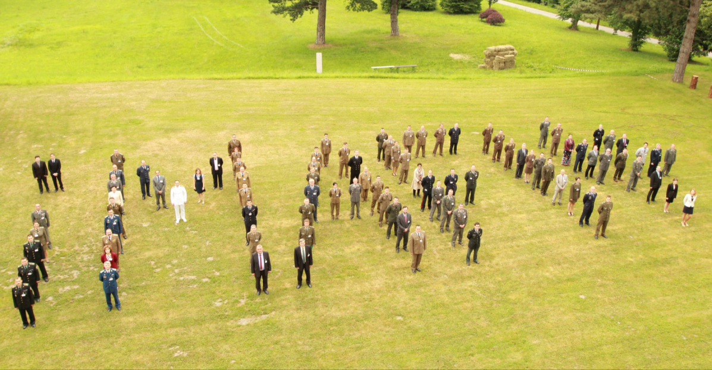
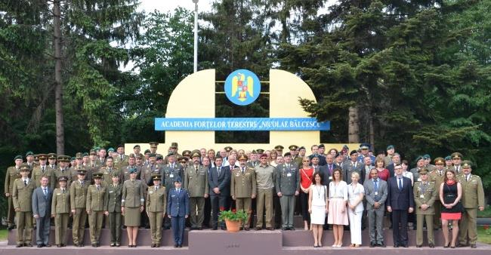
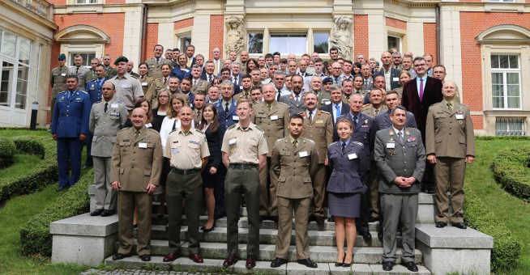
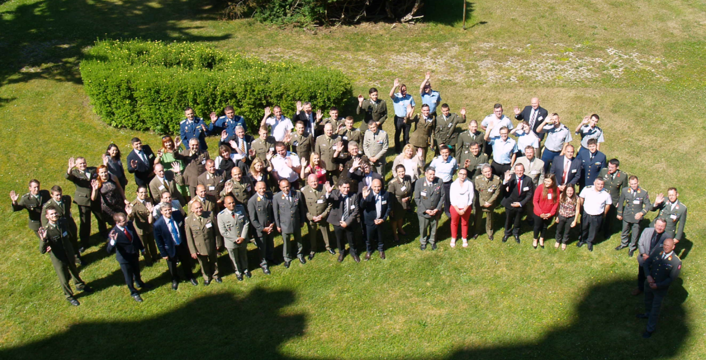
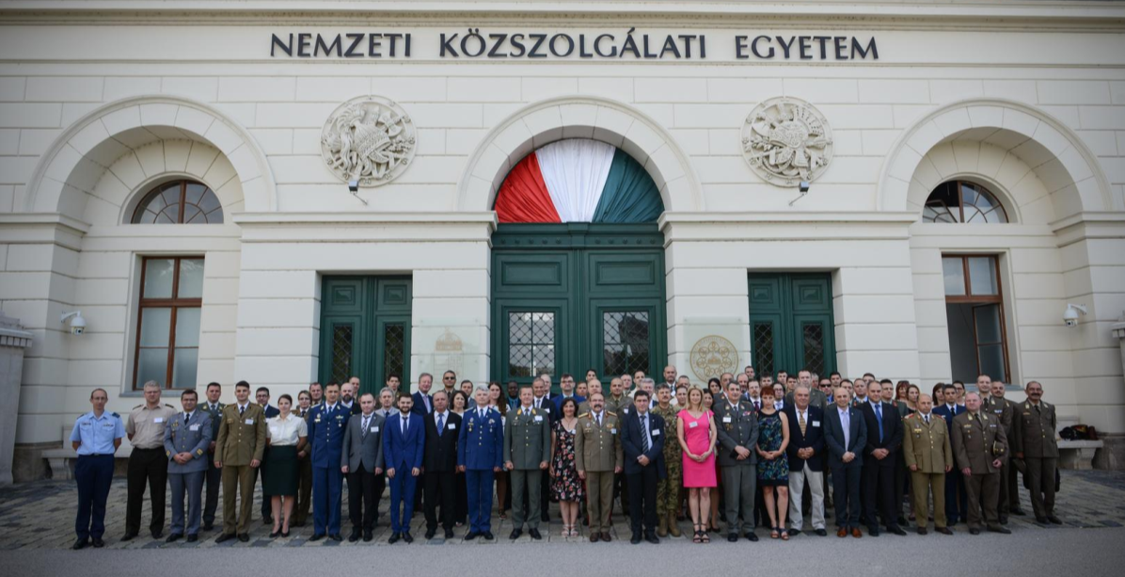
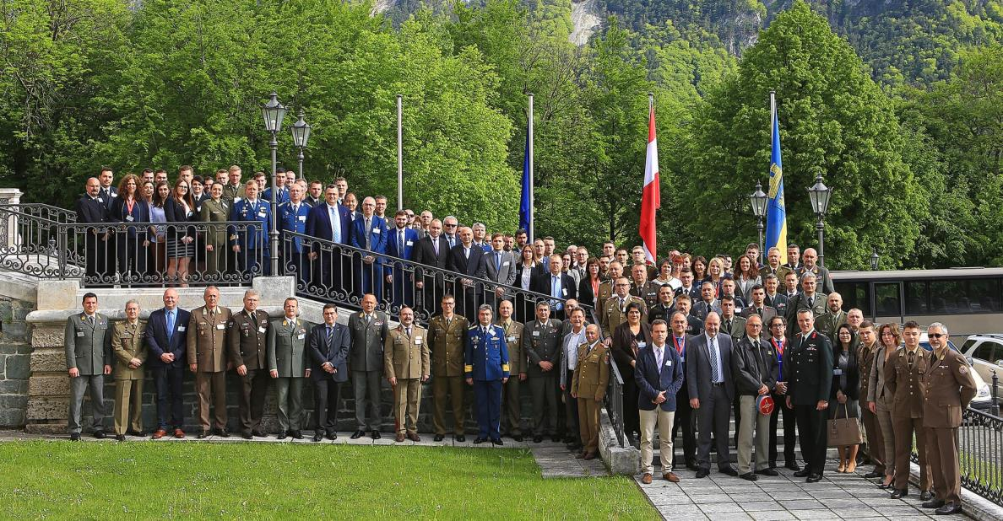
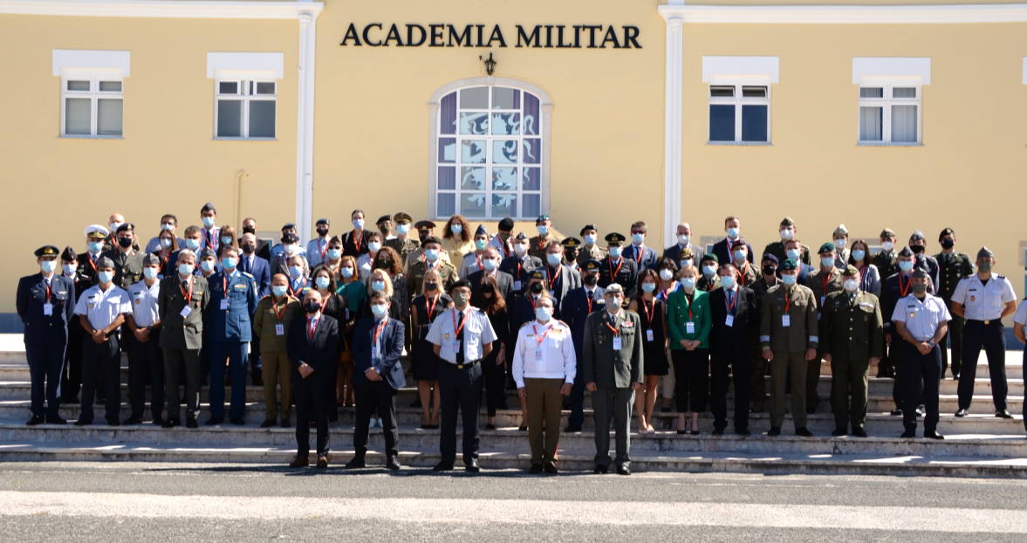
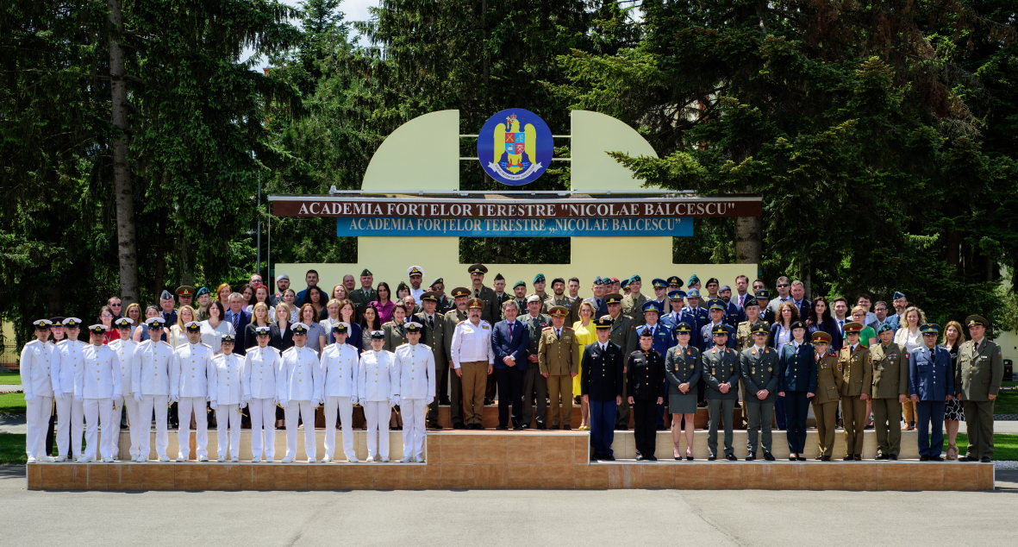
What are we doing? Meetings/Projects dedicated to the Initiative (iMAF)
2015: Romania
2014: Austria
2013: Austria
2016: Poland
2017: Czech Republic
2019: Austria
2021: Portugal
2022: Romania
2018: Hungary

Slide 34
Who is involved in iMAF?
New agreement in 2021 – all (22 +2) signed in 2022

Slide 35
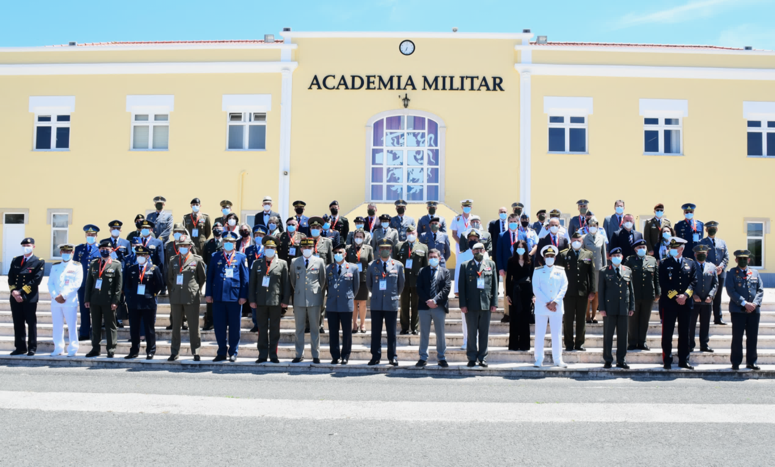
What are we doing? Meetings dedicated to the Initiative (EUMACS)
All Services!
Last EUMACS:
27-28 May 2021 at the Portuguese Military Academy

Slide 36
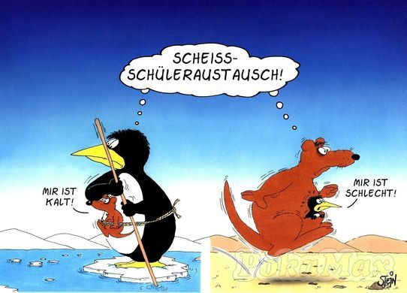
Cui bono?
Why
we conduct this stupid
exchanges ???
Why
we conduct this stupid
exchanges ???
I
feel
cold
I
feel
sick
Source: http://debeste.de/16253/Sch-leraustausch ; re-shaped by Col Gell

Slide 37
Cui bono?
need for financial investments
increased administration
Why
we conduct this stupid
exchanges ???
difficulties for recognition
of learning outcomes
language difficulties
cui bono
where to find
up-dated information
I
feel
cold
I
feel
sick
…. therefore, does it make
sense at all?

Slide 38
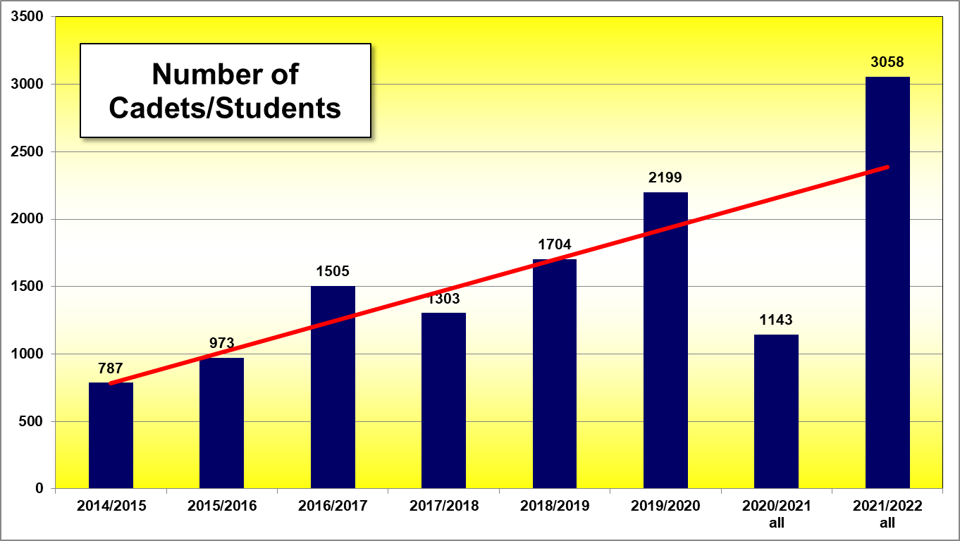
Study Year 2021/2022 Events under the Umbrella of / connected to the IG
trendline

Slide 39
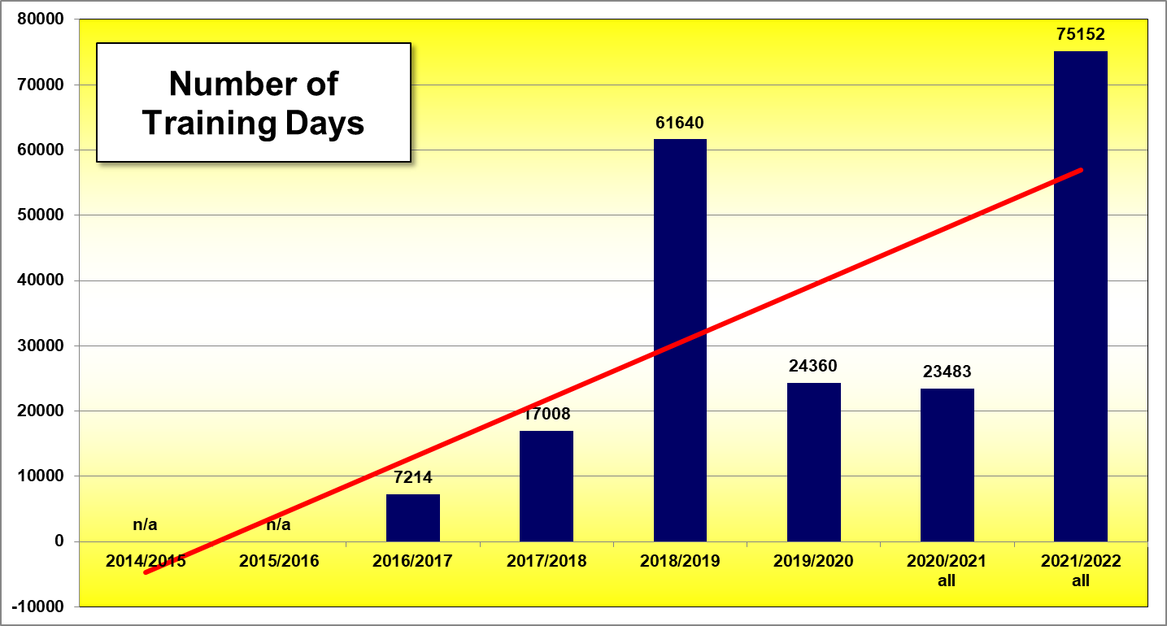
Study Year 2021/2022 Events under the Umbrella of / connected to the IG
Corona

Slide 40
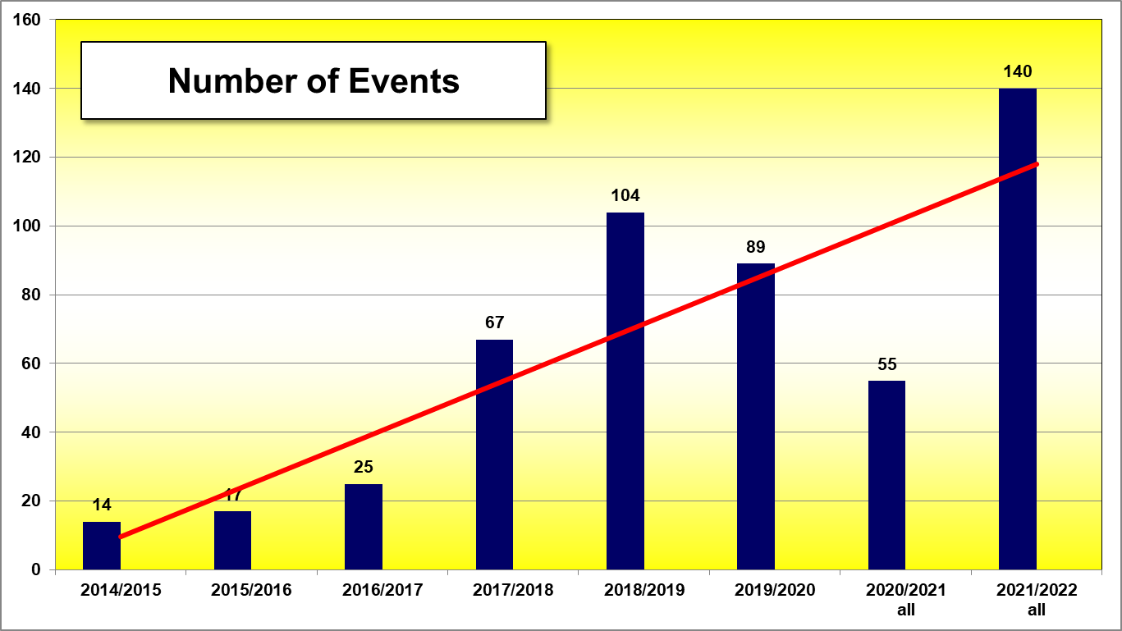
Study Year 2021/2022 Events under the Umbrella of / connected to the IG

Slide 41
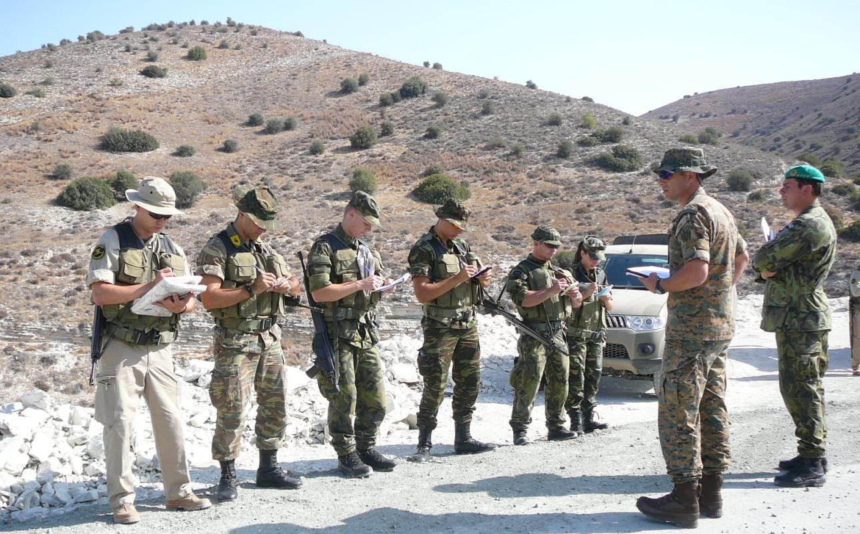
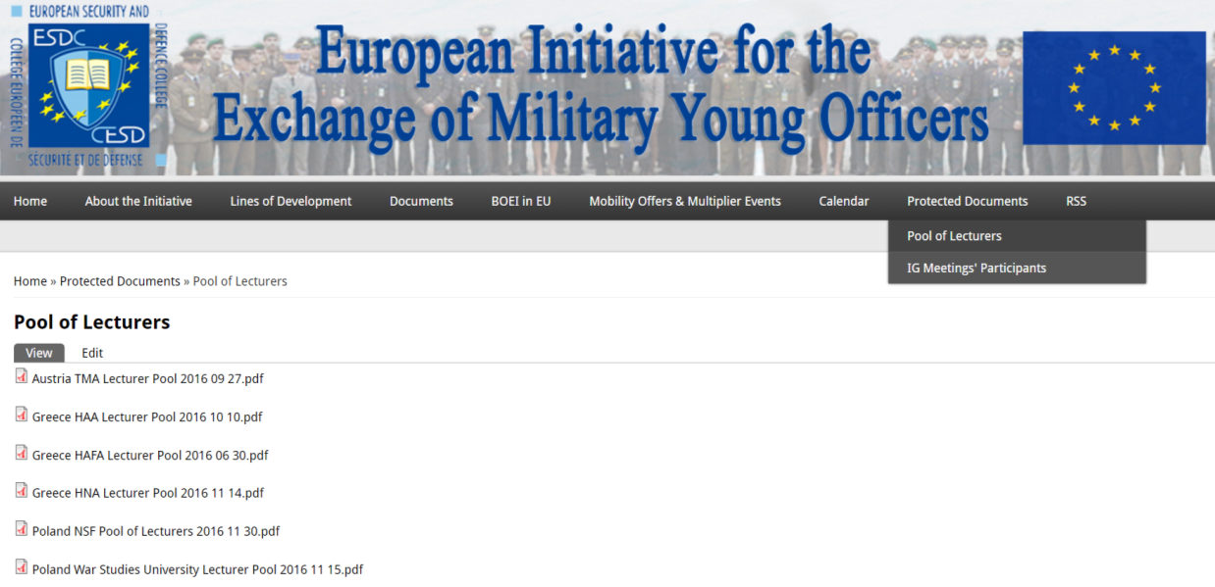
Cui bono? Lecturers’/Instructors’/Educators’ Exchanges
Available on PW-protected area on www.emilyo.eu
share experiences
pass knowledge to other EU BOEIs

Slide 42
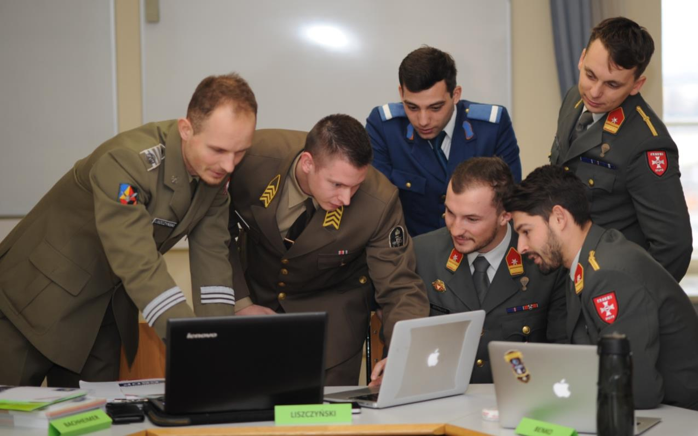
Conclusion Based on a huge scientific Research (Habilitation)
The European Initiative
with its international activities
increases students’
(Officer Cadets’ / future leaders’)
skills & competencies
(special knowledge, personal development, metabolism, self-confidence …)

Slide 43
Future Intent (GAREA proposals) based on YOUR Decisions
Integrate at least one common module to the national curriculum of each BOEI.
Align common modules qualification requirements with the SQF-MILOF.
Implementation of the International Air Force Semester (IAFS) and European Common Technical Semester on Defence and Security (E_{u}CTS-_{DS}).
Continue elaborating on an International Naval and Medical Semester.
Launch a new project for an International Air Defence Semester.
Examine R&D collaboration opportunities with the ESDC Doc School.

Slide 44
Clear Statement
All the elaborations of the EU Military Erasmus (EMILYO) Implementation Group focus onto the
academic
and
non-academic (vocational)
education for
young Officers / Officer Cadets / Midshipmen

Slide 45
Kind Requests
LoD-5 (Framework): Please opt in
Accreditation ⬅➔ Internationalisation ➔ creation of International Offices (separate Erasmus+ Coordinator[s])
Continue (or initiate) sending your representatives to the IG meetings (YOU shape the future)
Implement 1 Common Module (at least)

Slide 46
Summary
We act according to the decision of all your Ministers of Defence.
We use – whenever possible – external funds.
We promote a European Security and Defence Culture.
We depend on YOUR support.

Slide 47
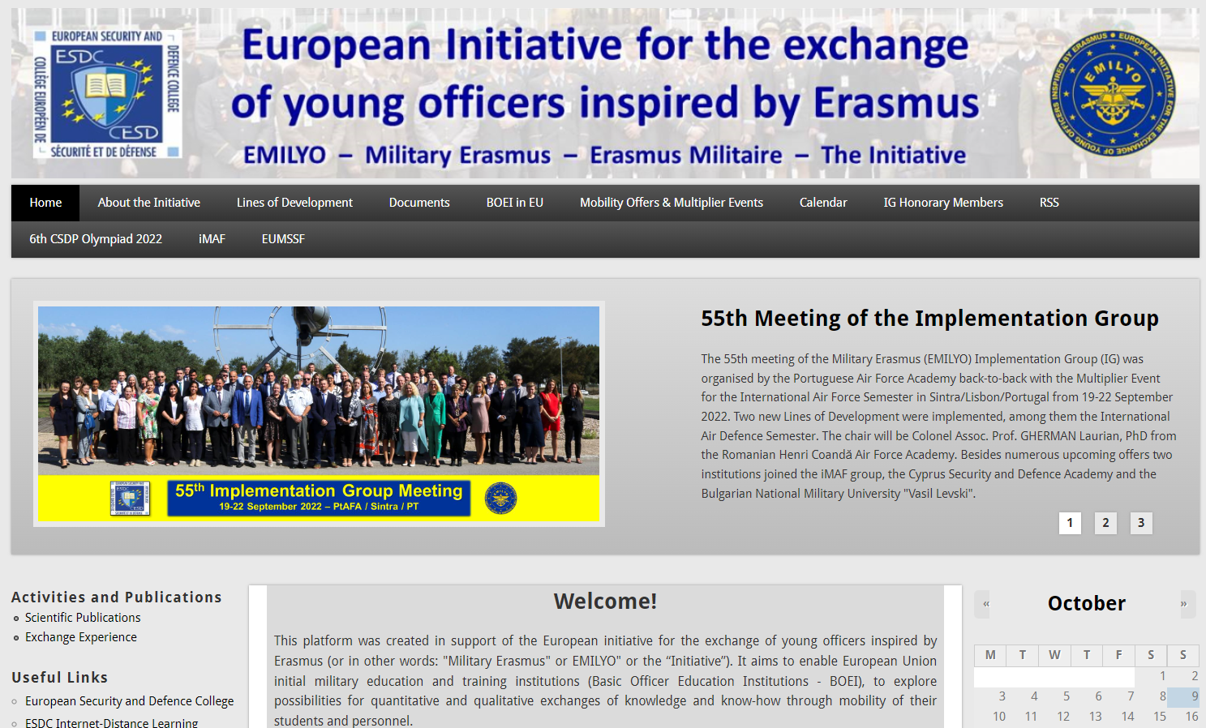
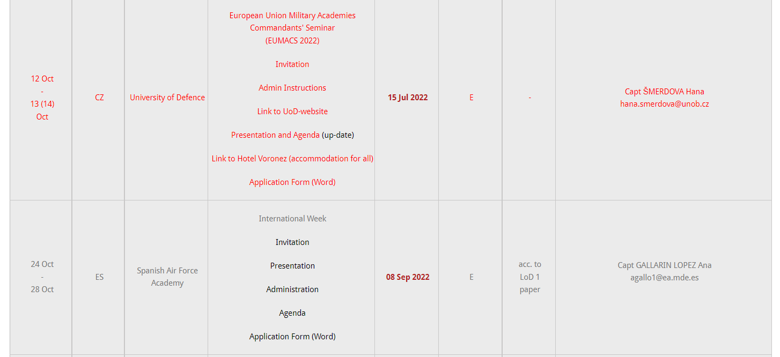
Further Information www.emilyo.eu

Slide 48
Thank YOU for YOUR attention!

